Slide 1
React Native Intro Workshop
Evan L Daley

Slide 2
Agenda
Activity | Time
Introduction to React Native | 5 minutes
Creating an App with the Expo CLI | 5 minutes
Creating Our First Component | 10 minutes
Component Styling | 5 minutes
Creating Our Second Component | 5 minutes
Creating a FlatList | 10 minutes
Form Elements | 10 minutes
Passing Props | 20 minutes
Wrapping up | 10 inutes

Slide 3





Hola!
My name is Evan L. Daley
Instructor Lead for Spokane nucamp community.
Full Stack Dev for etailz inc.
Fun fact: I have two cats (Charlie and Abby)

Slide 4
Welcome to React Native!
Here are some of the key concepts
That I’ll be going over this evening:
Next slides will review these concepts, along with the Exercises you did this week.
Expo CLI to scaffold the app Custom Components React Native Components: <View>, <Text>, <Icon> <ScrollView> | react-native-elements <Card> react-navigation createStackNavigator createDrawerNavigator

Slide 5
Web App vs. Native Mobile OS App
React Native is a JavaScript framework for writing real, natively rendering mobile applications for iOS and Android.
It has a React-like component structure. Many things are the same, some different.
We will use Built-in React Native components/elements as well as a separate library called React UI Elements.
React Native gives you a standalone mobile app (not a web page).
Can access native features (camera, push notifications, ARKit, device storage, location features, etc)

Slide 6
Expo Toolchain
A free and open source toolchain built around React Native to help you build native iOS and Android apps using JavaScript and React.
Wirelessly deploy to your phone or an Android/iOS emulator in seconds.
Over the air updates to published projects.

Slide 7
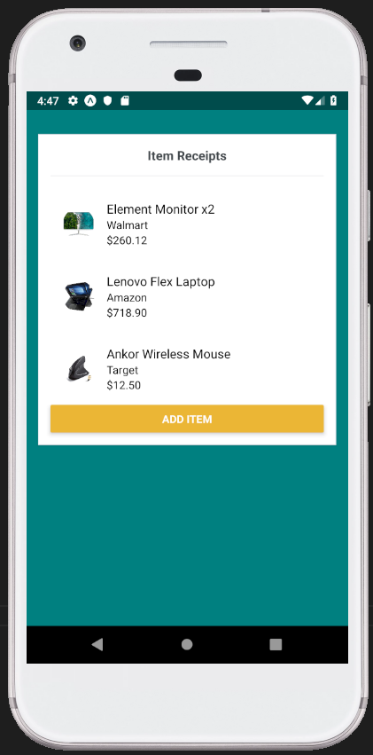
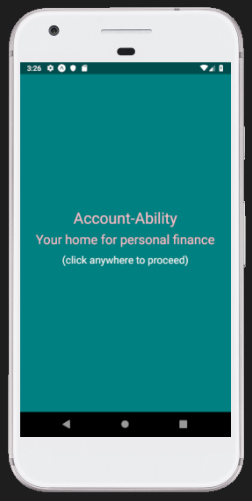
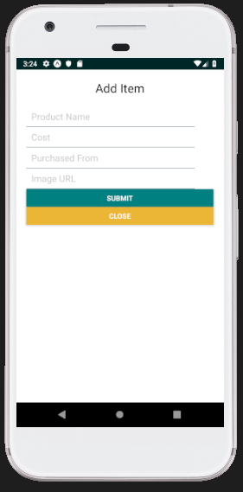
Today’s Goal

Slide 8

Today’s Goal
Functional Component
Custom Styles (color, font, padding)
TouchableOpacity for handling touch events

Slide 9
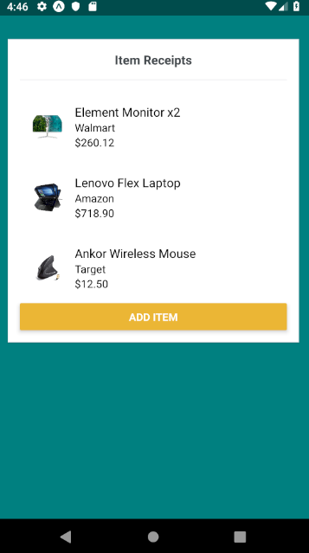
Today’s Goal
Class Component
Button
Card
Flatlist & RenderItem with Images
Read/Save State

Slide 10
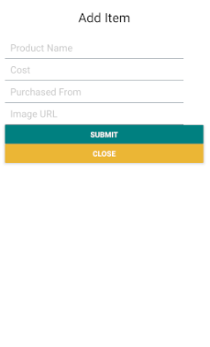
Today’s Goal
Modal
Form Elements
Buttons

Slide 11
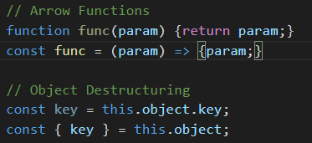
Skill Check-In
JavaScript ES6
Arrow functions
Class Inheritance
Object Destructuring
React
Components
State
Props

Slide 12
Exercise Creating a React Native App
The Expo CLI – Objectives:
Use the Expo CLI to scaffold out a React Native app
expo init demoApp
Serve the project using:
expo start
If you want to try it out you can install the Expo client app on your Android/iOS device scan the QR code on the screen.

Slide 13
React Native Components Part 1
Objectives:
Create a home screen called “Home” as a functional component.
Set up the App component to render Home as its child component.

Slide 14
Demo: Creating a splash screen

Slide 15
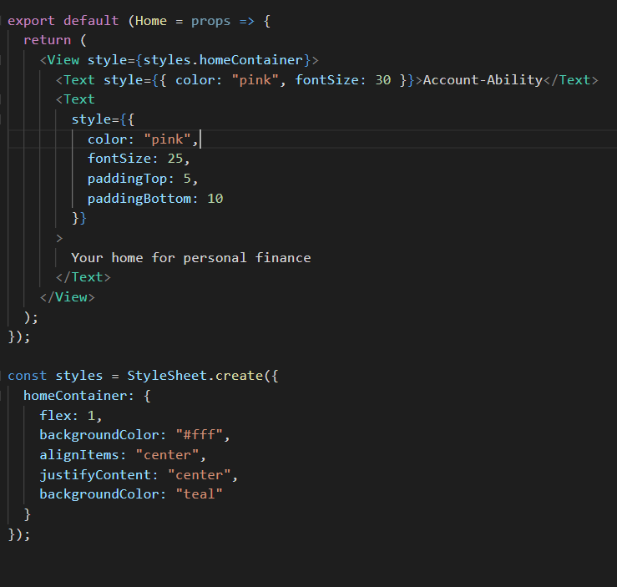
React Native Components Part 1 (cont)

Slide 16
React Native Components Part 2
Objectives:
Add a “click anywhere to proceed” message.
Update the App.js component state with
{ isAwaitingClick: true }
Handle the click with a TouchableOpacity component.
{ isAwaitingClick: false }
Render components conditionally based on state.isAwaitingClick

Slide 17
Demo: User action triggers the the next page to load

Slide 18
React Native Components Part 2
Objectives:
Add Card component for the receipts
Read data from shared items.js file
Add FlatList component
Create RenderItem component for elements in FlatList

Slide 19
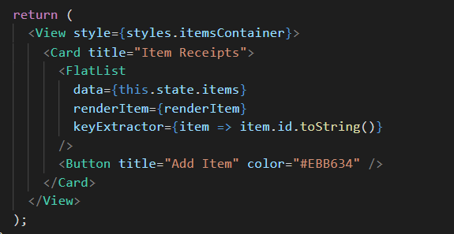

Slide 20
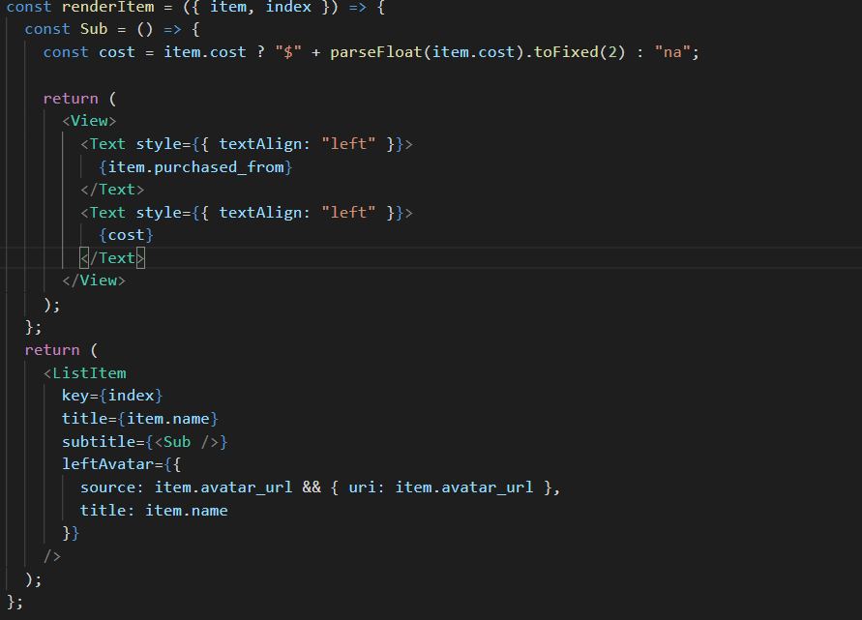

Slide 21
React Native Components Part 2
Objectives:
Add the “Add Item” Button
Add modalVisible to Item component state.
Toggle modalVisible value when “Add Item is clicked”

Slide 22
Demo: User action triggers modal

Slide 23
React Native Components Part 2
Objectives:
Add form fields to modal.
Save new item to component state.

Slide 24
Going Forward
Each of these concepts is covered in the Nucamp React Native course:
Camera support
Access permissions and storage
Proper state management with Redux
How to persist application state to device storage
Push notifications
Animations
Complex app navigation (layers, tabs, menus)

Slide 25

Thanks for coming!
Now you can stand up an app with the Expo cli. You can create components, and navigation elements. And you know how to handle props and state!
If you want to go deeper, ask me about Nucamp. We have a 4 week React Native course.

